Slide 1


Slide 3

22 Months on Managing Windows Servers with Windows Admin Center

Slide 4



Jan-Tore Pedersen
Senior Consultant @ GTClobal
Cloud and Datacenter MVP
Blog: https://jtpedersen.com
Twitter: @jantorep
Speaker and Organizer for SCUG.no
Azure Stack HCI S2D/Hyper-V
System Center
Software-defined Datacenter
Azure
Azure Stack HUB

Slide 5
Who is using Windows Admin Center?

Slide 6


Lightweight & fast deployment
Access from
Microsoft Edge
Google Chrome
Client browser
Install on
Windows Server (Semi-Annual Channel)
Windows Server 2019
Windows Server 2016
Windows 10
Windows
Admin
Center
Manage
Windows Server (Semi-Annual Channel)
Windows Server 2019
Windows Server 2016
Windows Server 2012 R2
Windows Server 2012
Windows Server 2008 R2
Windows 10
Managed nodes

Slide 7
Day to day usage
Demo

Slide 8




Core management tools
Server role management
Built for hybrid
Partner ecosystem
Performance monitoring
Packet monitoring
Server Core management with Edge
Add Connections – Unified cluster connection, Add Azure VM
5. Improvements based on your feedback
BMC IP address, Azure VM portal link
Files – Editable paths, File share support
Connectivity setting
Pending reboot banner
WinRM over HTTPS
Updates – Individual updates
Power profile settings
Hyper-V VM management
VM live migration
Import/export VM
VM tagging
Cluster management
Cluster deployment
Unified cluster connection
Azure Stack HCI management
S2D and cluster settings
HCI diagnostics tool
SDN – FlowLog Audit, Load balancer, Public IP tools
IIS, DNS, DHCP management
AD Users and Groups management
Azure Security Center integration
Azure Monitor – Alerting for servers and clusters
Azure Extended Networking
Storage Migration Service – Migrate file servers to Azure VMs
Azure File Sync – Sync a folder
Storage Replica – Create and use Azure VMs as secondary SR site
Azure Arc for Servers – Centralized governance via Azure Policy
Cloud witness – Use Azure as your quorum witness for 2-node clusters
New server and Azure Stack HCI hardware management extensions from Dell EMC, HPE, NEC, Thomas-Krenn
Updated hardware management extensions from Lenovo, Fujitsu, DataON, QCT, Pure Storage (flash array)
Software solution extensions from BiitOps (configuration change tracking) and Squared Up (monitoring)
Easy discovery + installation of extensions

Slide 9












Extend on-premises into Azure
Centrally manage from Azure
Business continuity & disaster recovery
Secure
Monitor
Update
Azure Site Recovery
Azure Backup
Storage Replica
Azure Security Center
Azure Monitor
Azure Update Management
Extend on-premises capacity
Storage
Govern
Azure File Sync
Storage Migration Service
Compute
1 0 0 1
Cloud witness
Create Azure VM
Azure Arc for Servers
Azure Policy
Networking
Azure Network Adapter
Azure Extended Network

Slide 10
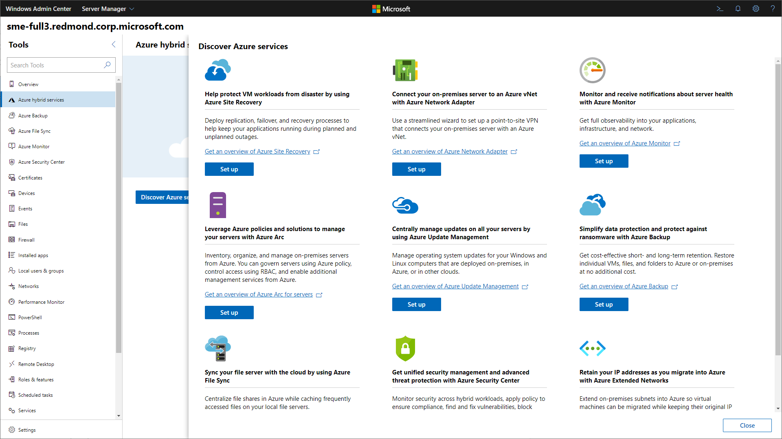

Slide 11
WAC Tools
Demo

Slide 12











Windows Admin Center Partners

Slide 13
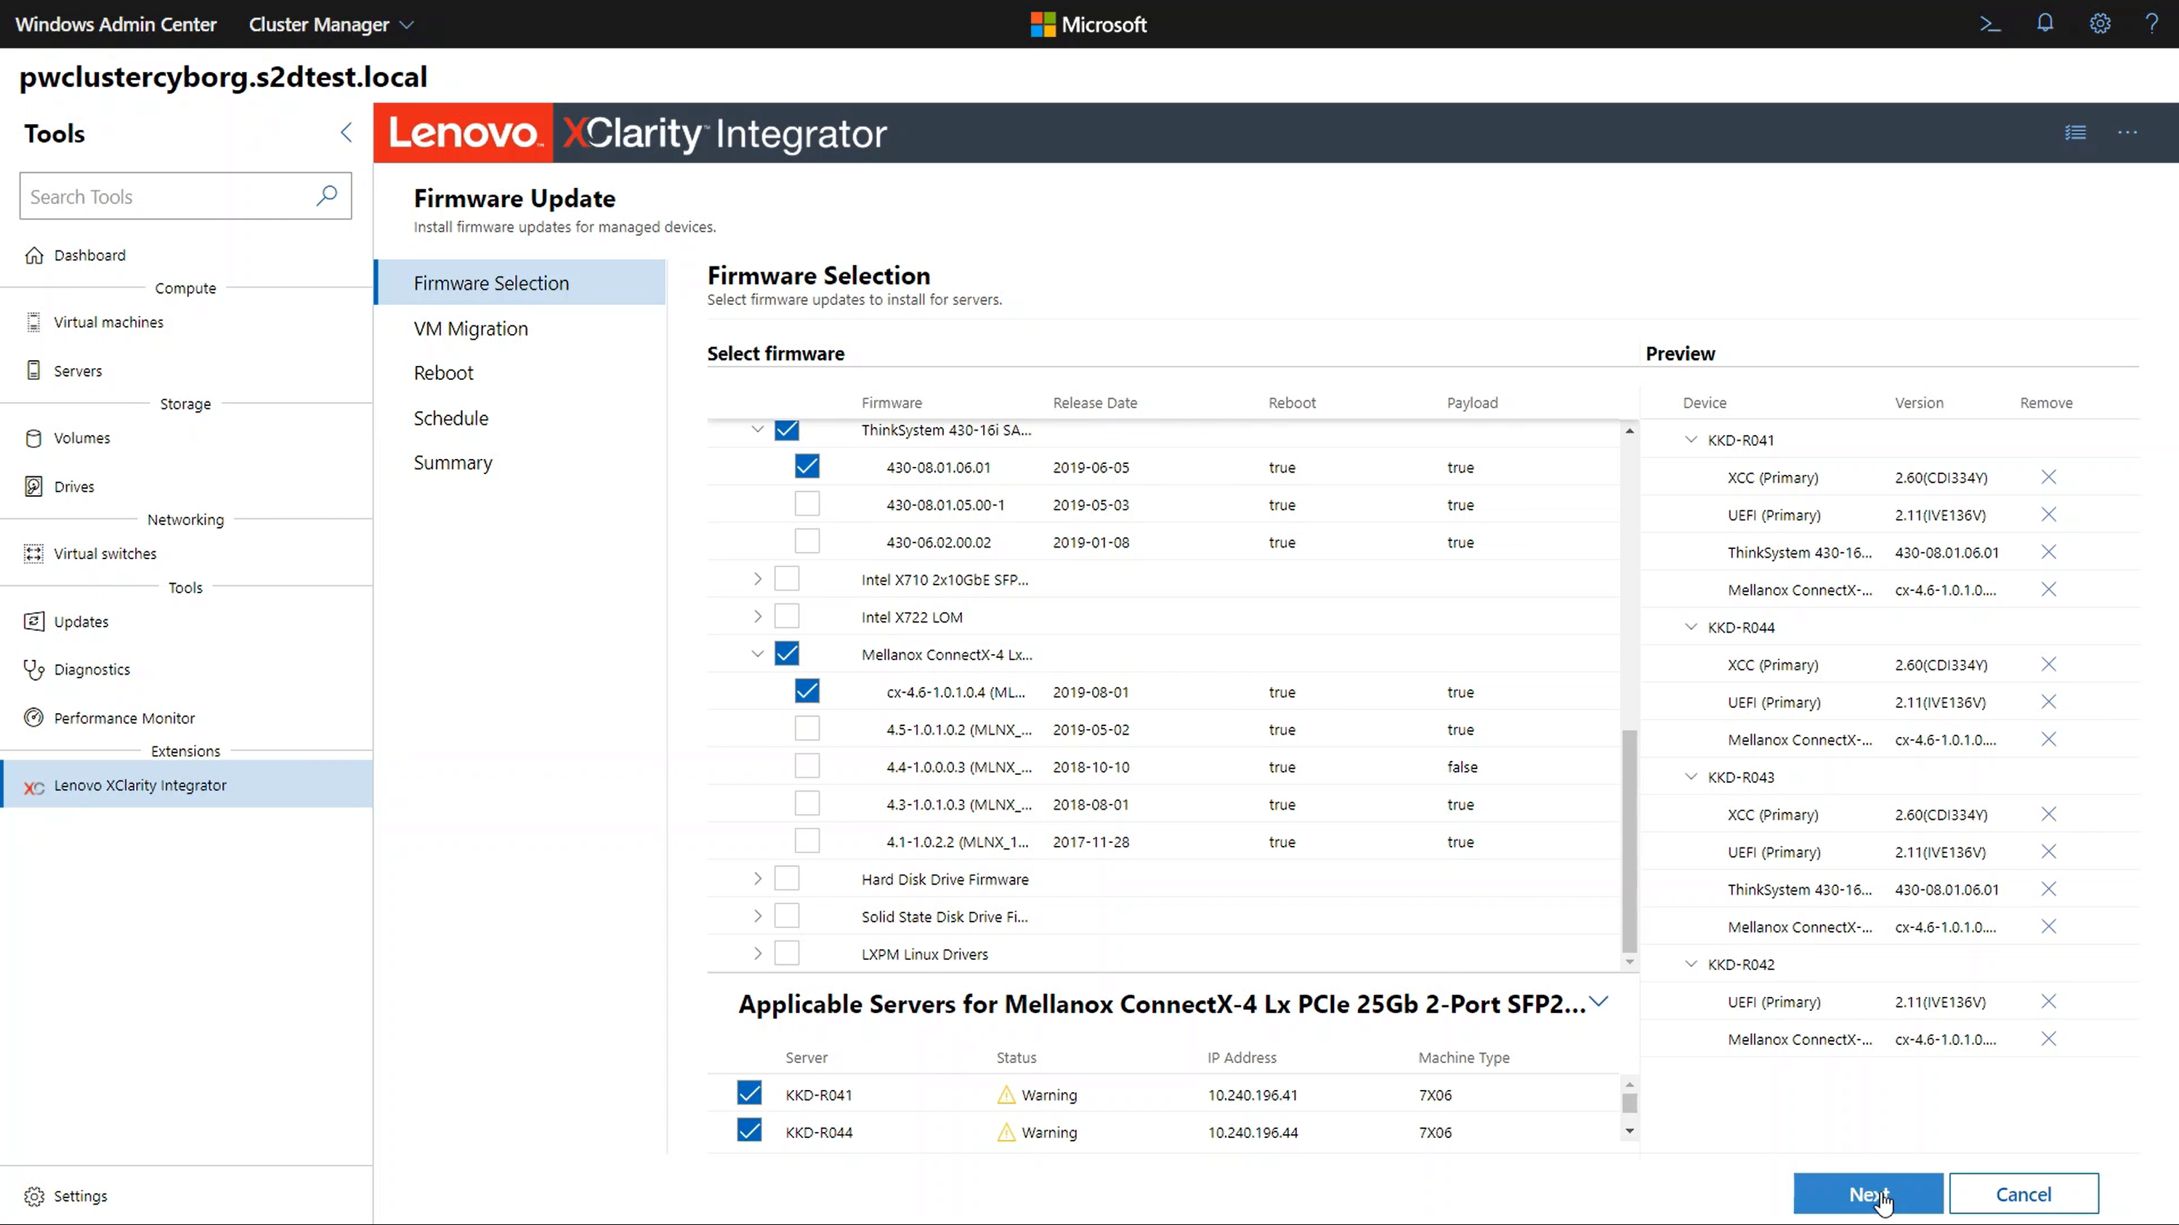

Slide 14
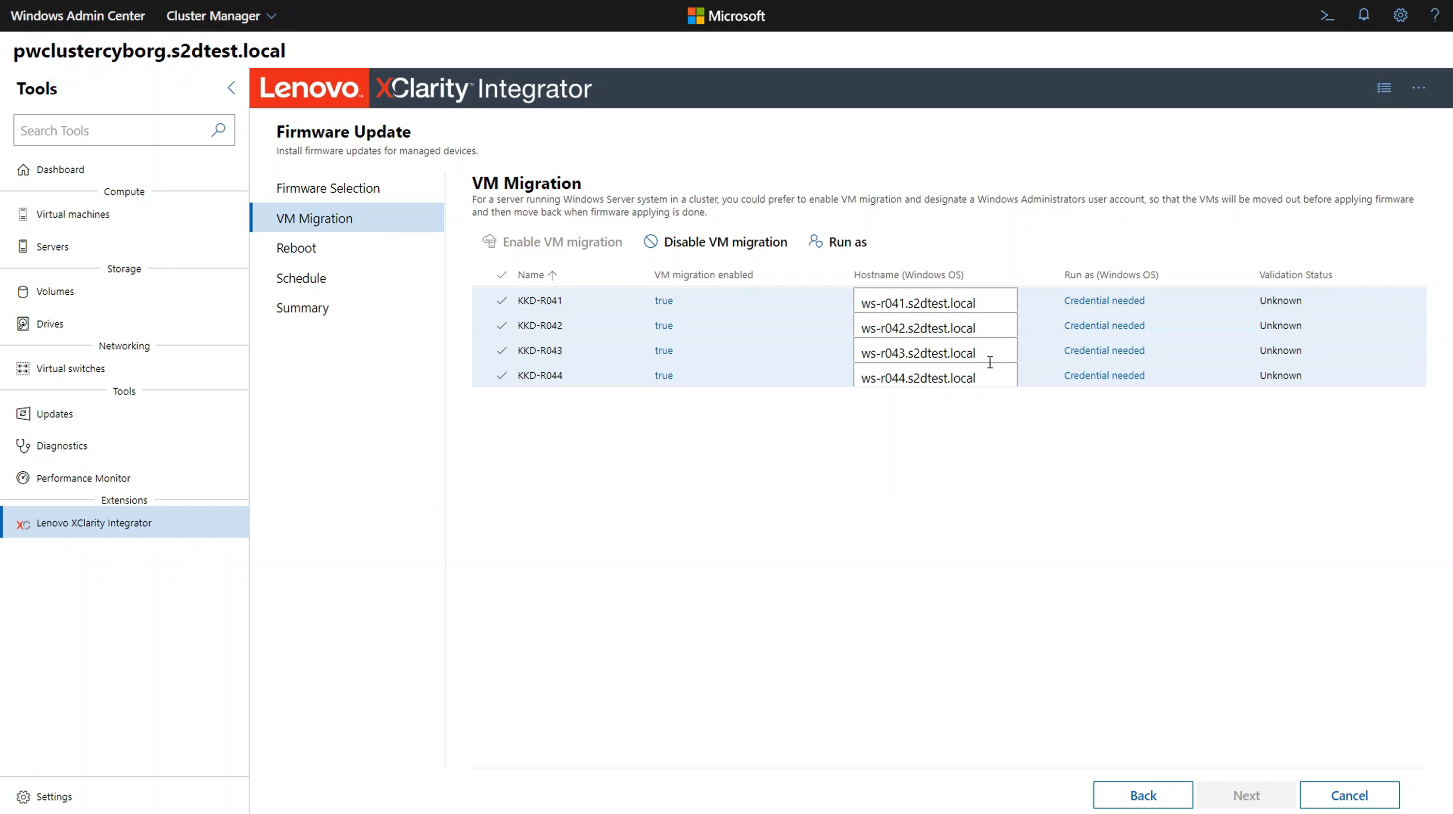

Slide 15
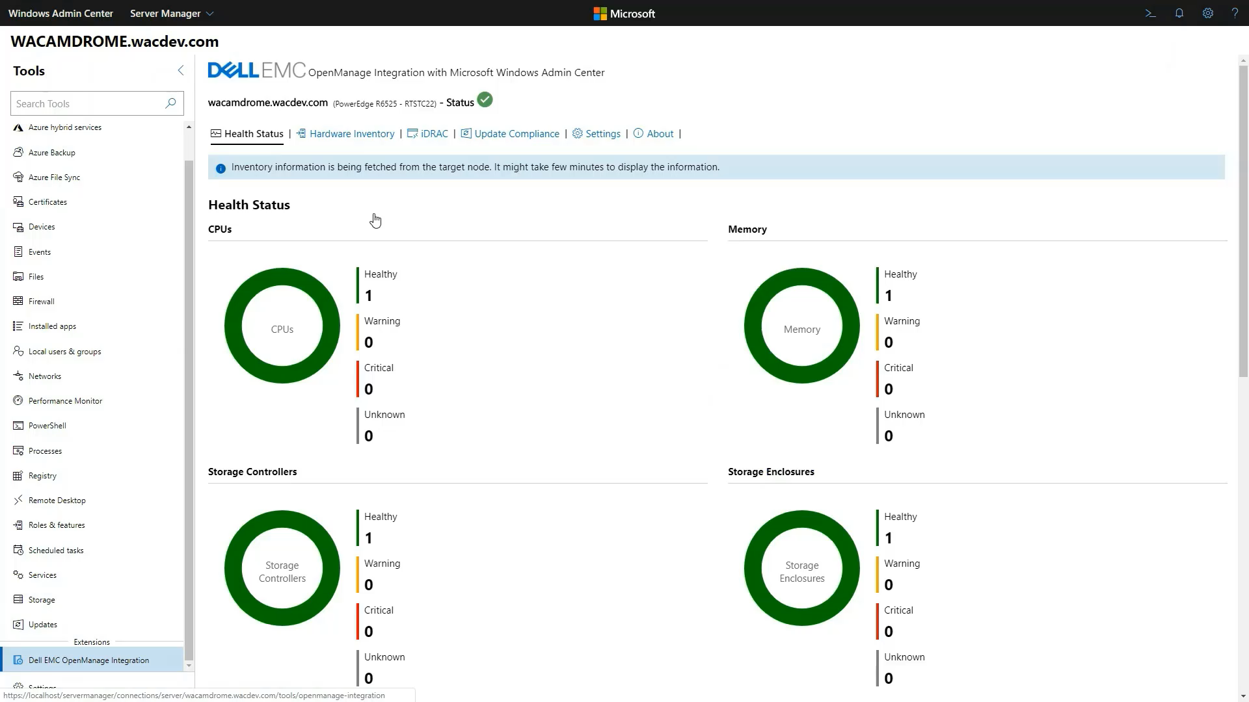

Slide 16
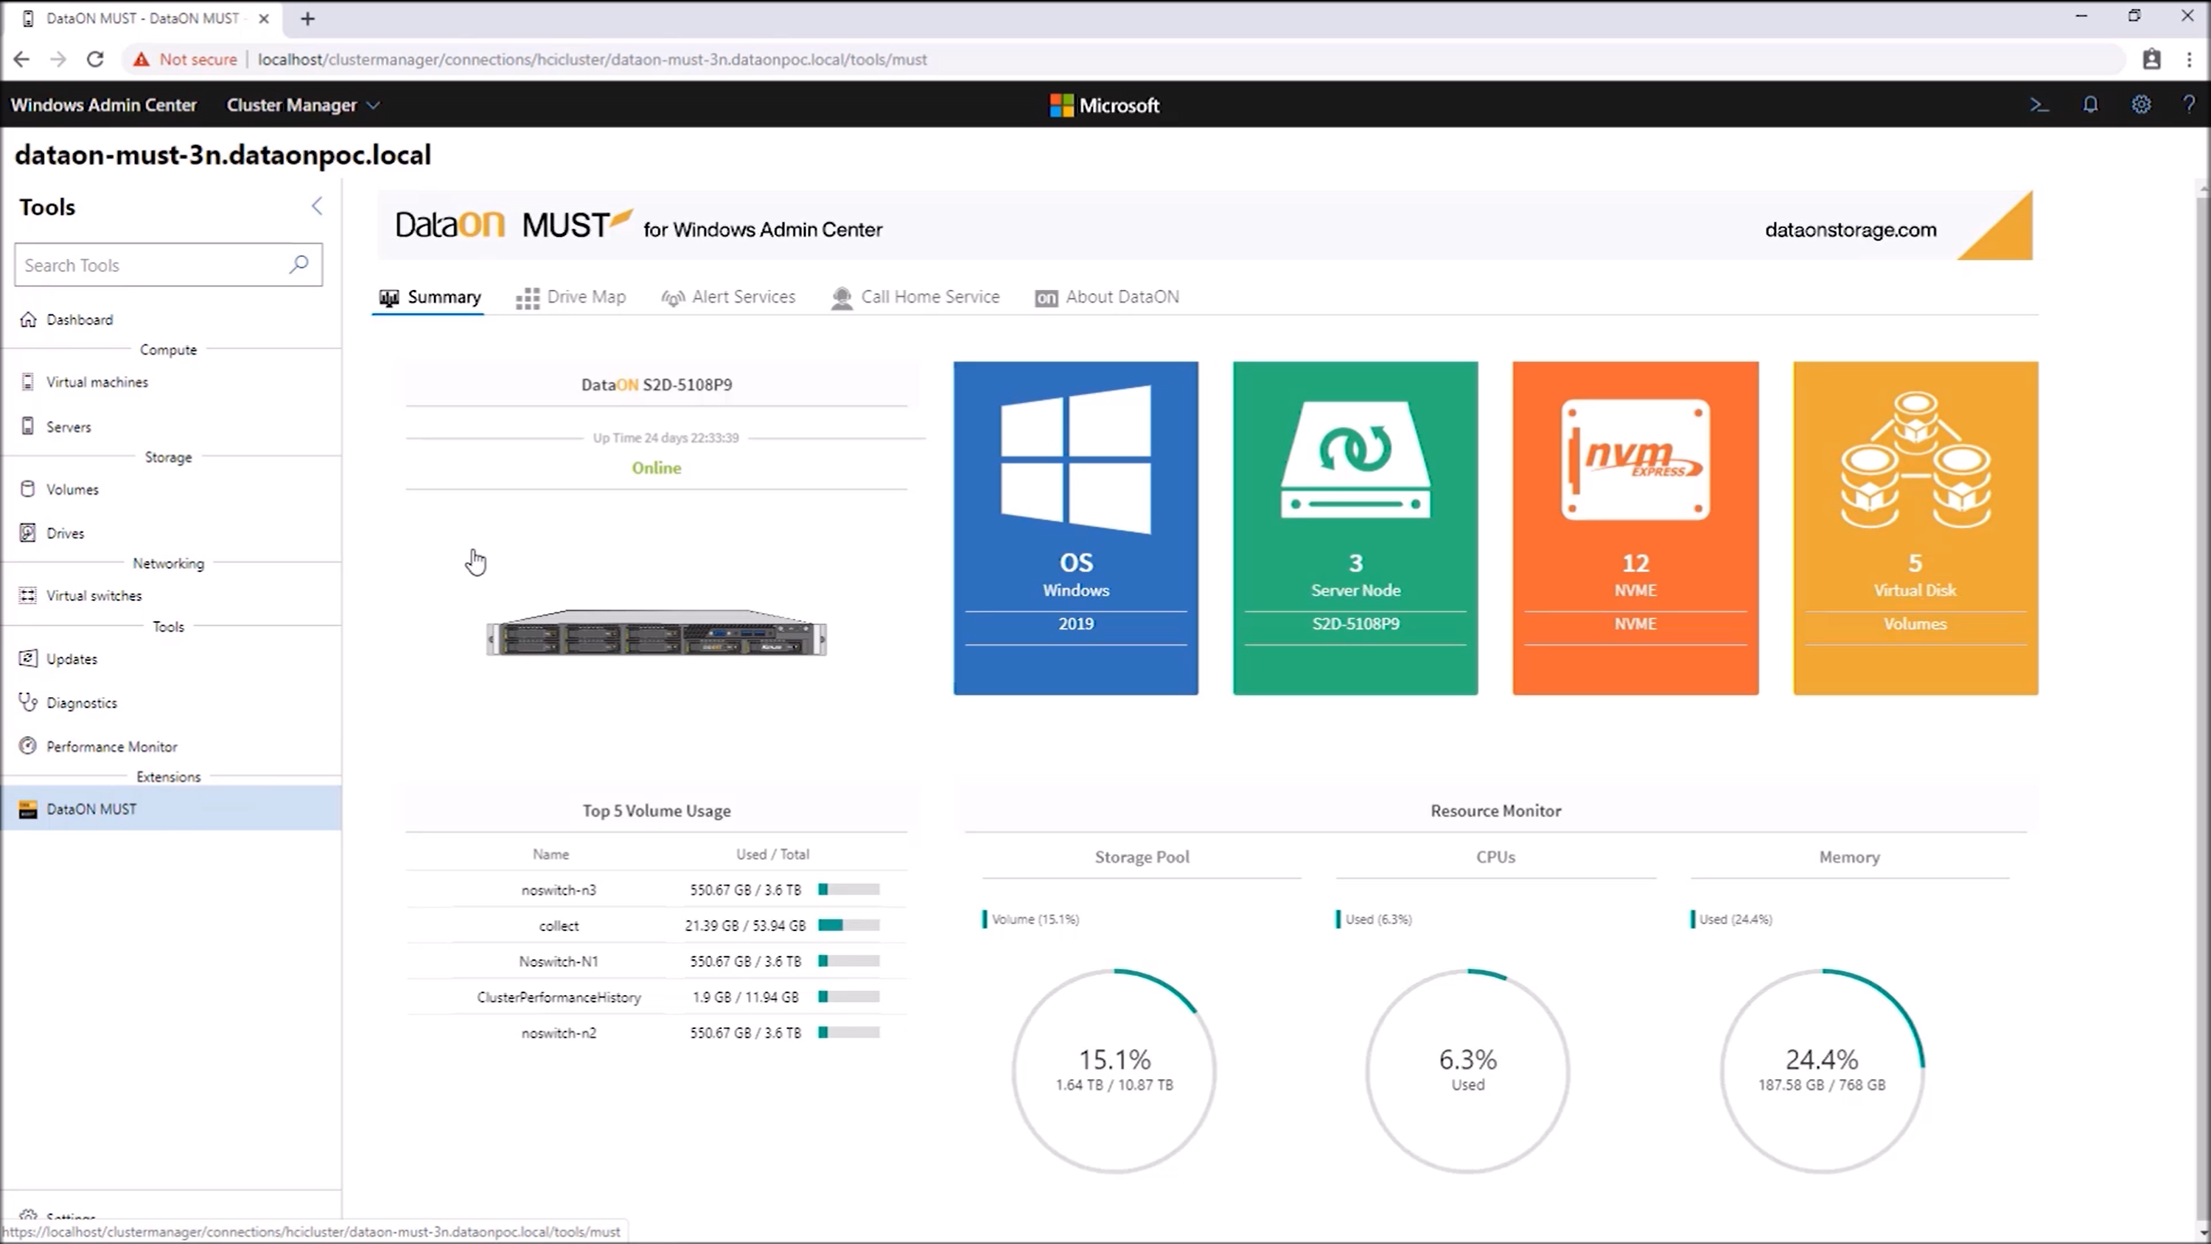

Slide 17
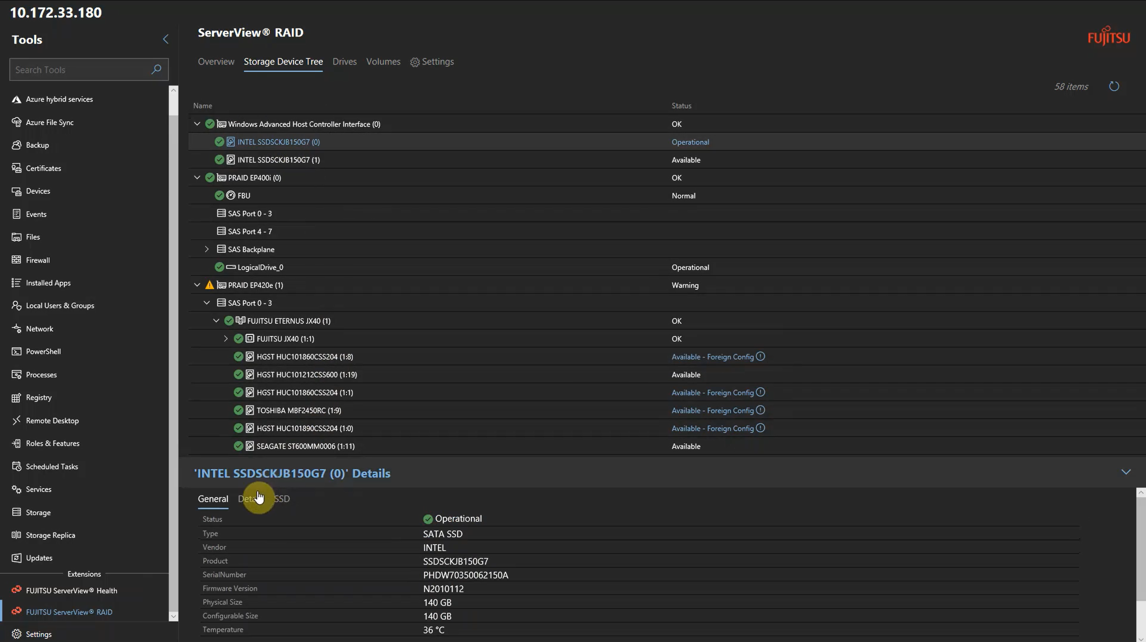

Slide 18
Extension
Demo

Slide 19
Questions

Slide 21
Slides and demos from the conference will be available at
https://github.com/nordicinfrastructureconference/2020

